Slide 1
Time Series Analysis in Rankings of American Universities
Zuchen Li, Kun Cheng, Yishan Ren, Xiaoyu Sun

Slide 2
Content
Introduction
Data Collection and Pre-Processing
University Rankings Analysis and Prediction Model
Results
Discussion
Conclusion

Slide 3
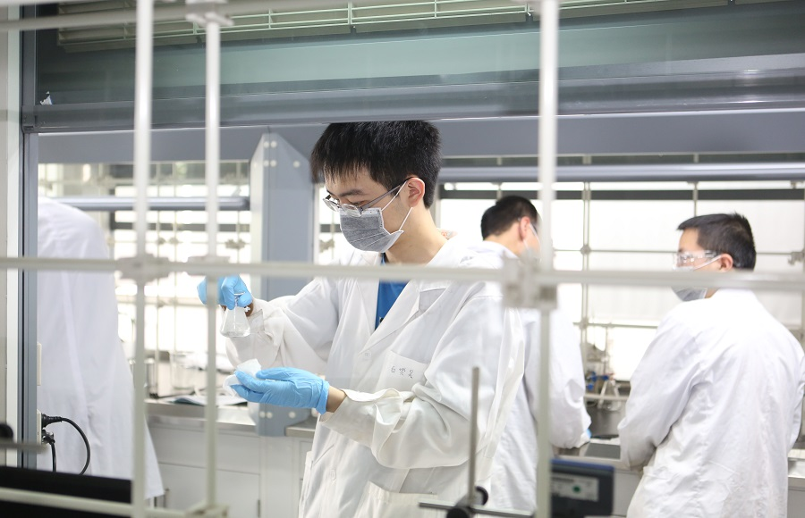

Introduction

Slide 4





Introduction

Slide 5
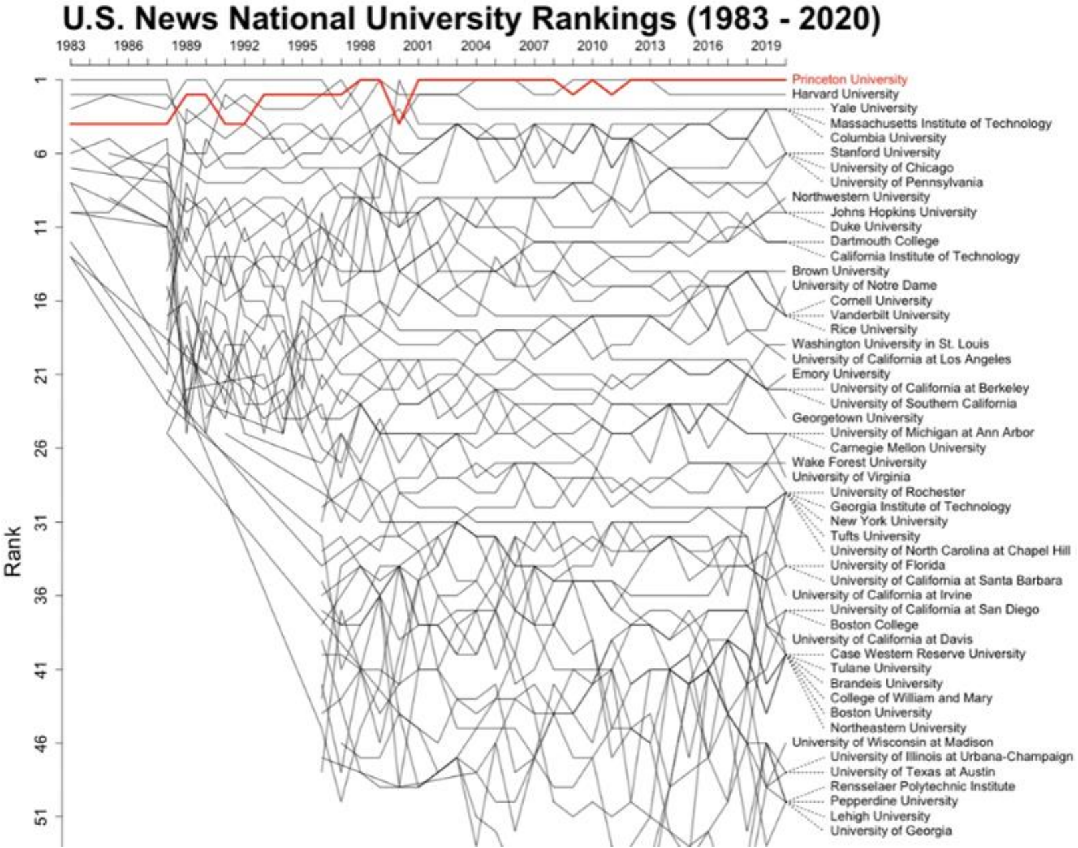
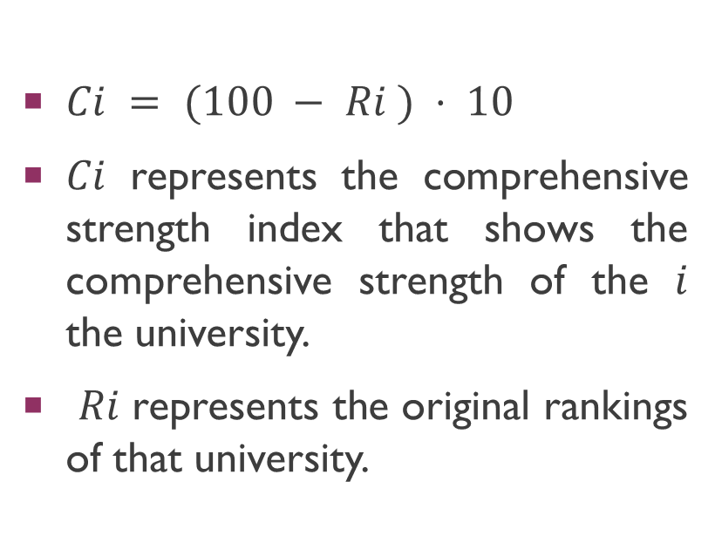
Data Collection and Pre-Processing
$Ci = (100 − Ri ) ⋅ 10$
𝐶𝑖 represents the comprehensive strength index that shows the comprehensive strength of the 𝑖 the university.
𝑅𝑖 represents the original rankings of that university.

Slide 6
Model Selection
Time Series Problems
Correlation Problems
Vary with time.
Only has one variables.
Focus on self change pattern recognition.
Independent Variables and Dependent Variables.
Correlation or Association or Causation
Focus on dependence relations.

Slide 7
Why Exponential Smoothing
Actually Short-term time series
The recent data has stronger effect in the future rather than the old data.
Stationary series.
Most of these schools’ historical data does not contain trends.
No apparent functional relationship.

Slide 8
Single exponential smoothing

Slide 9
Single exponential smoothing

Slide 10
Single exponential smoothing

Slide 11
Quadratic Exponential Smoothing

Slide 12
Quadratic Exponential Smoothing

Slide 13
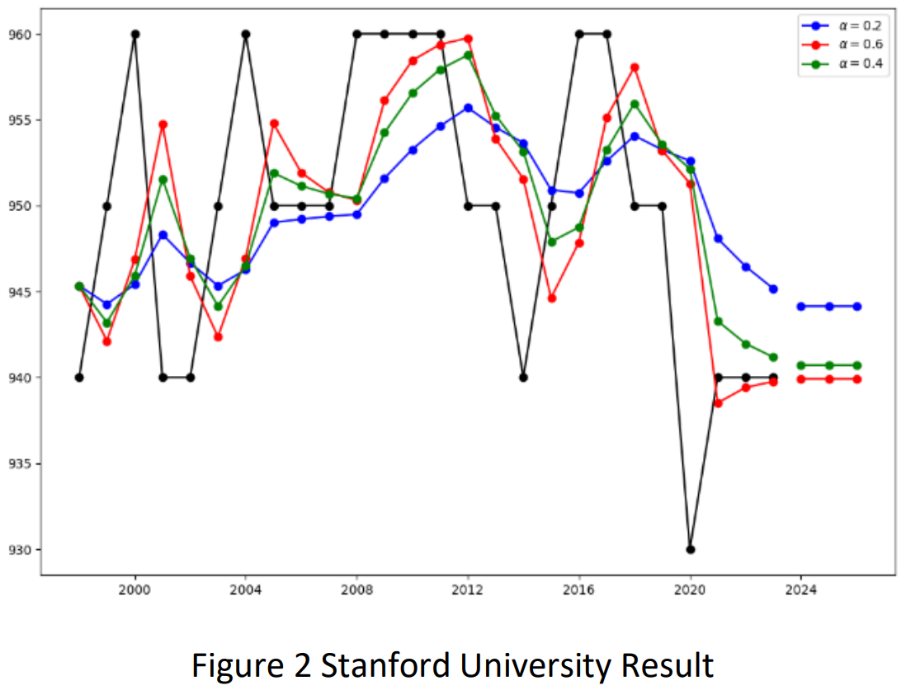
Results

Slide 14
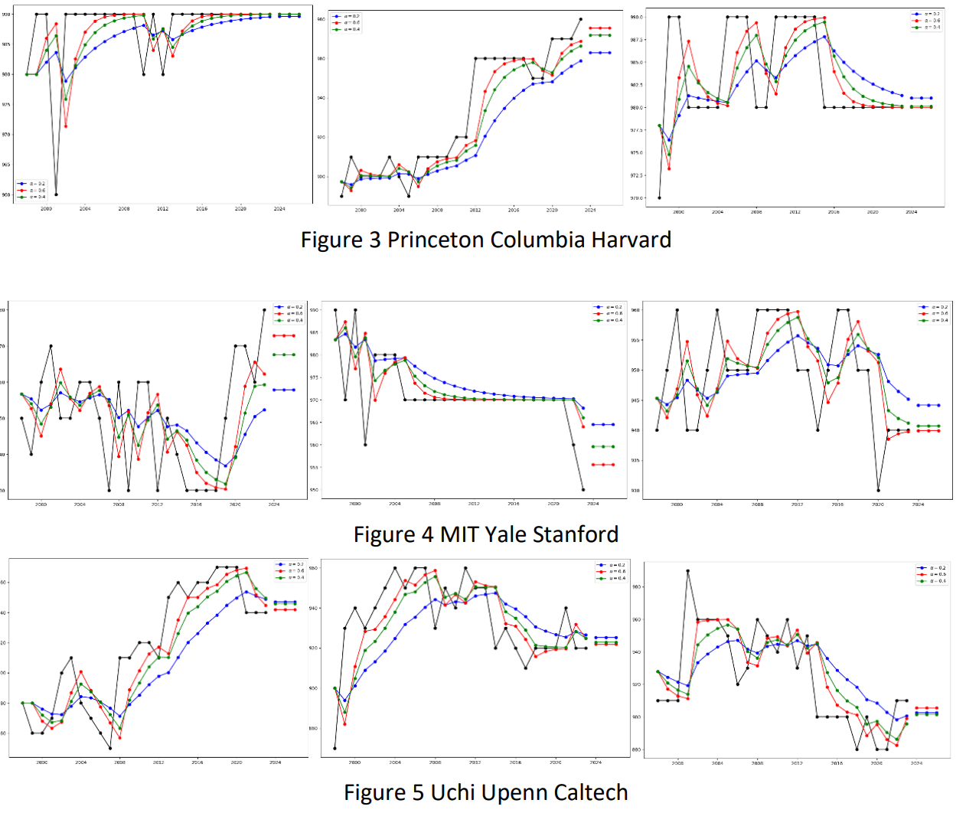
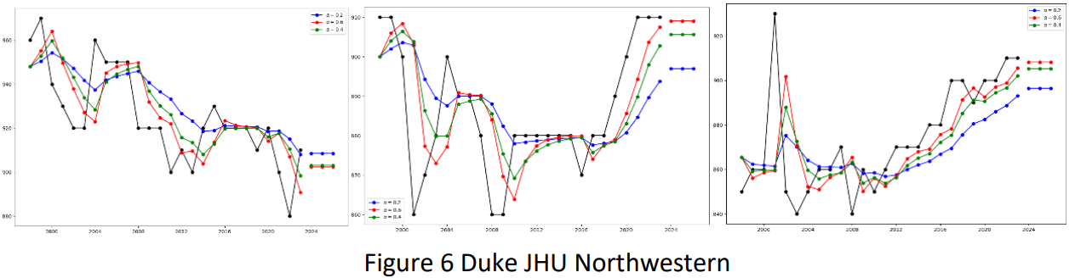
Results

Slide 15
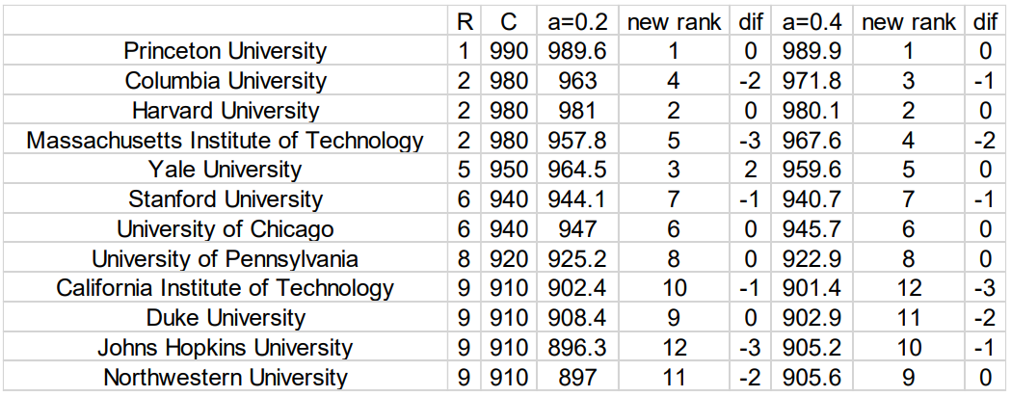
Results

Slide 16
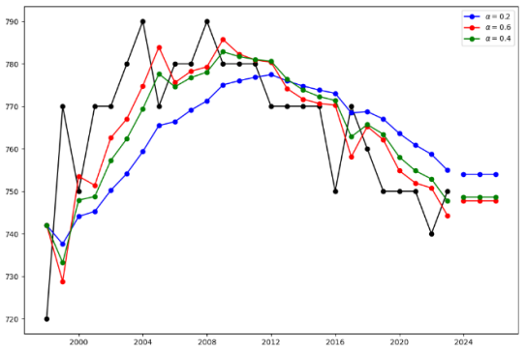
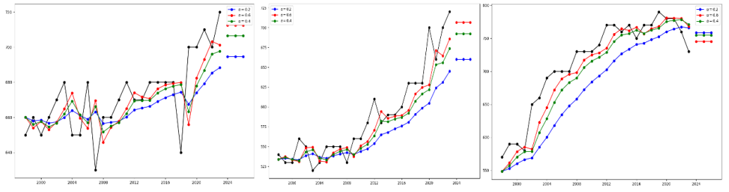
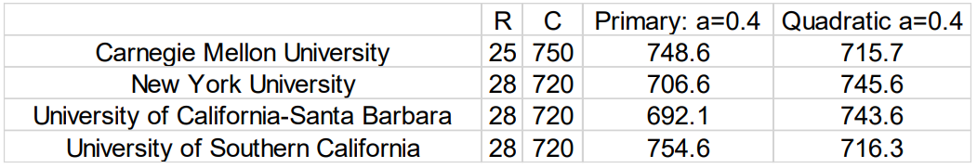
Results

Slide 17
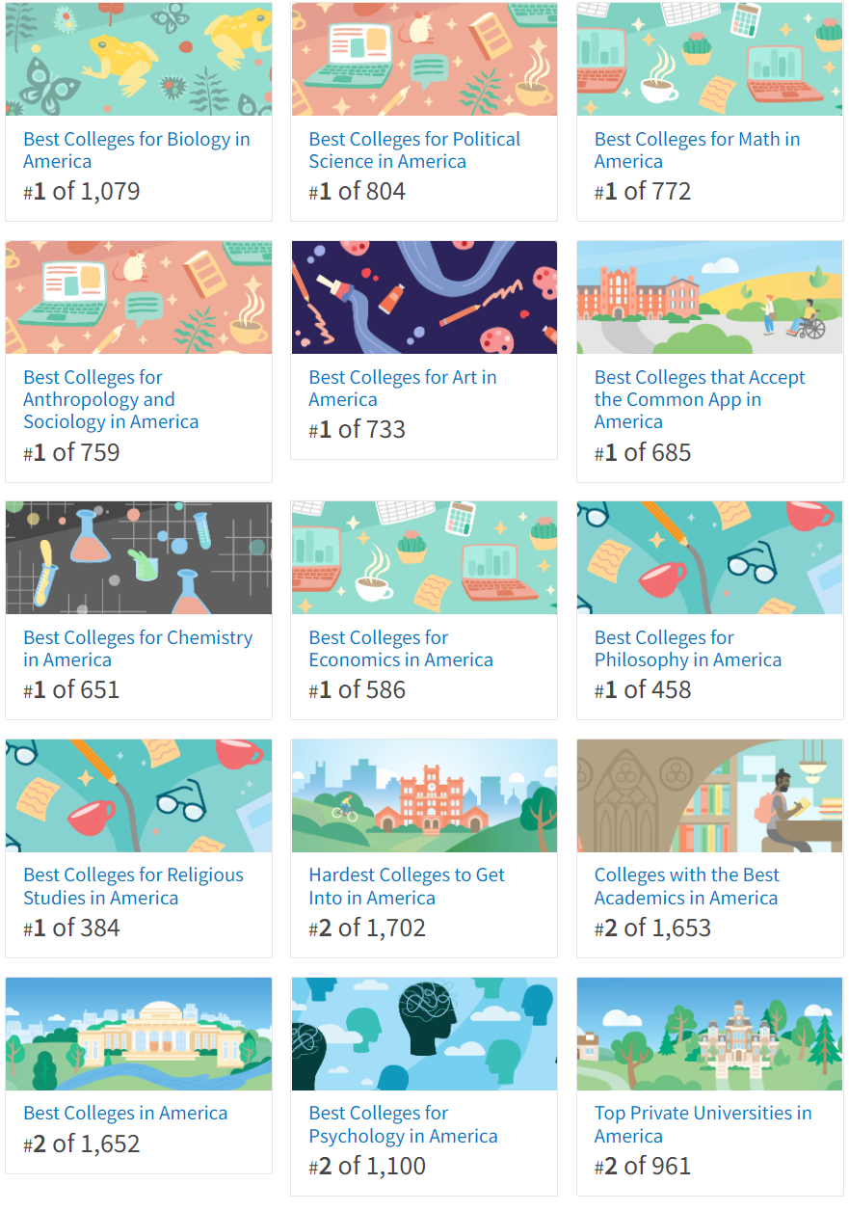
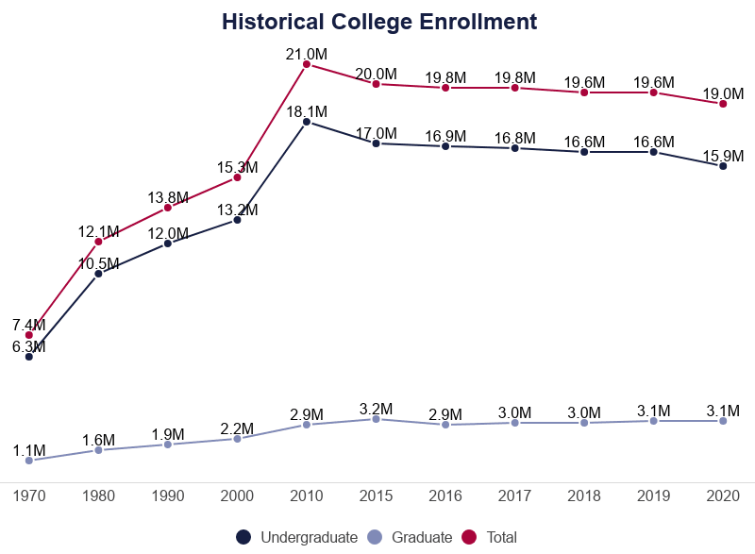
Discussion

Slide 18
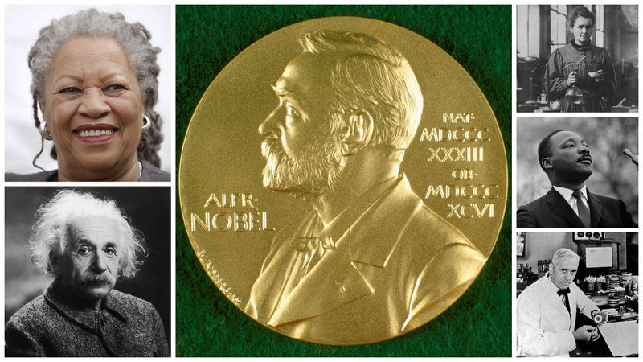

Discussion

Slide 19


Discussion

Slide 20
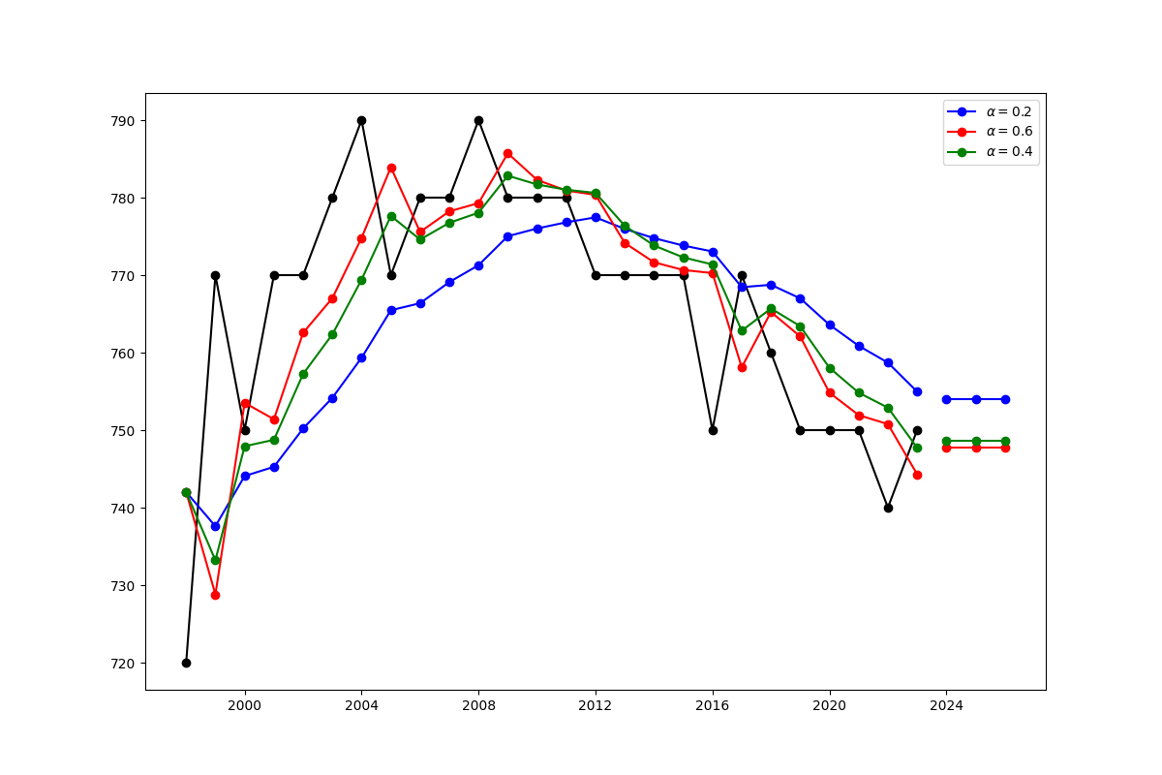
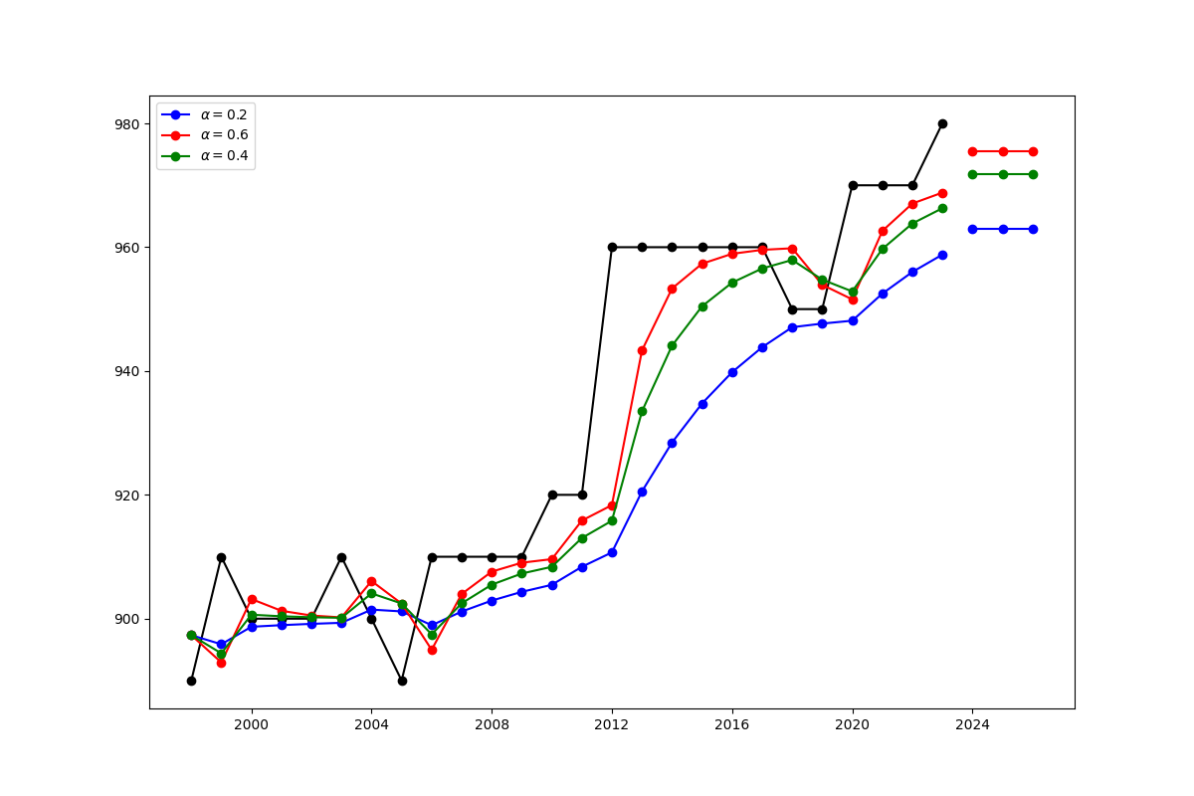
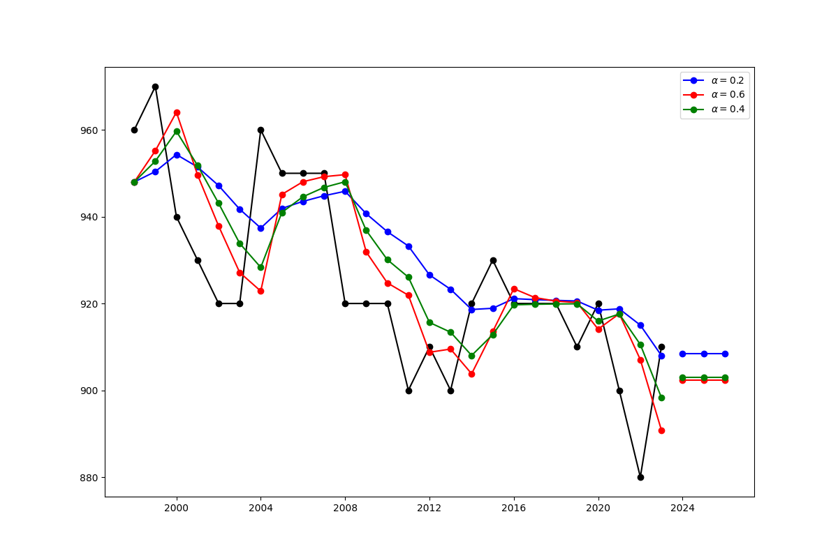
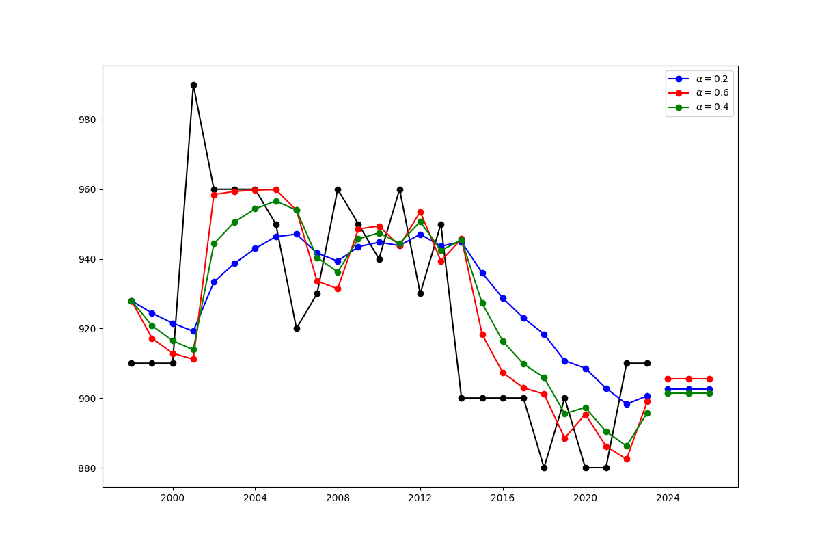
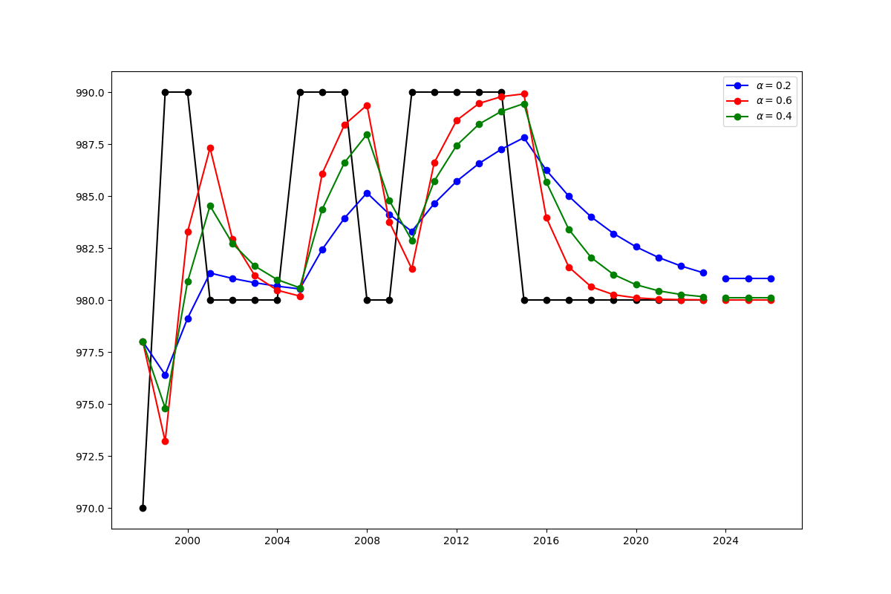
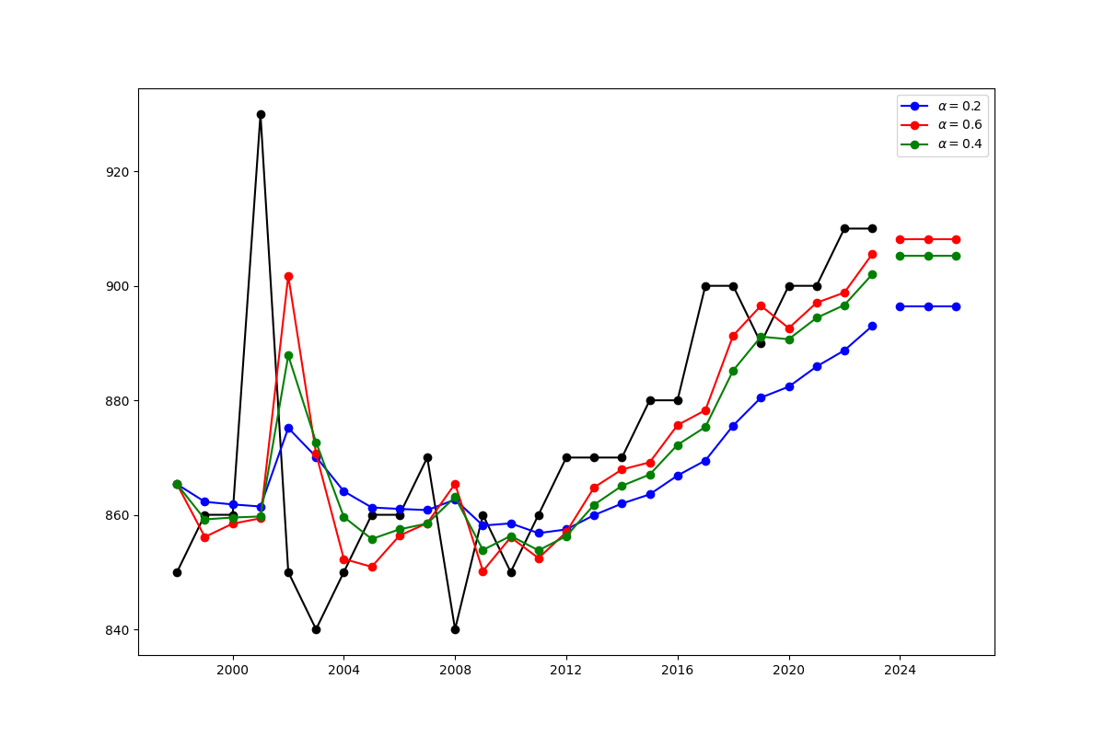
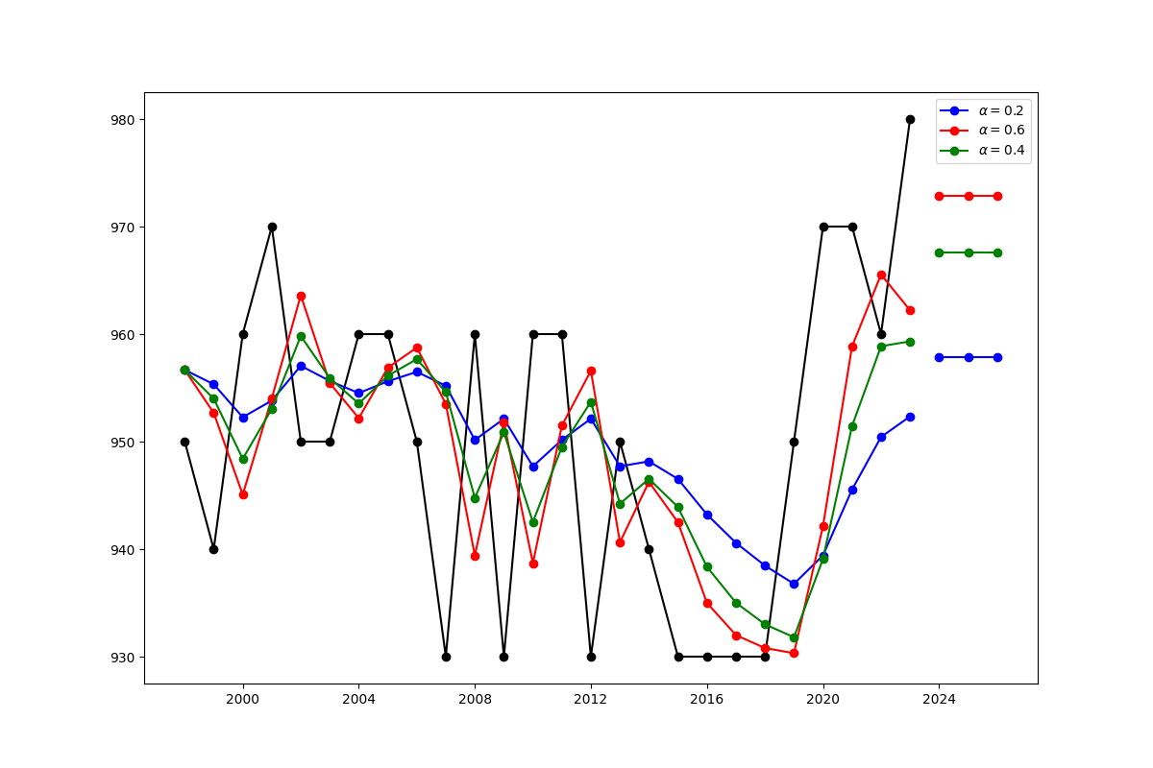
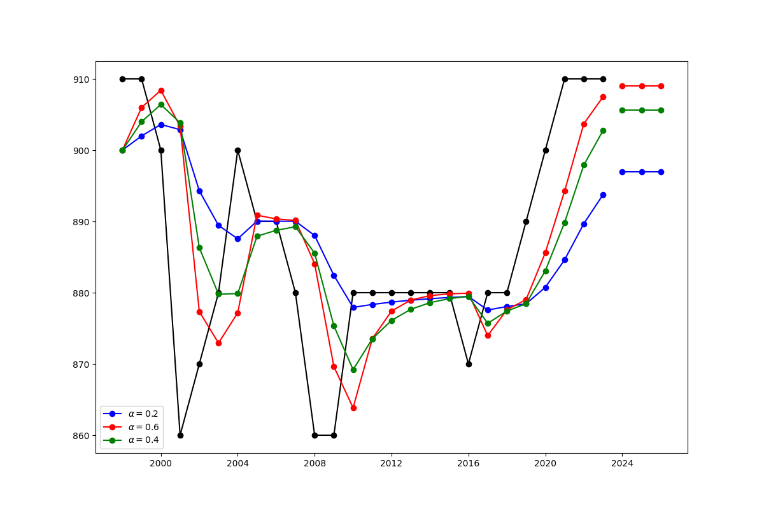
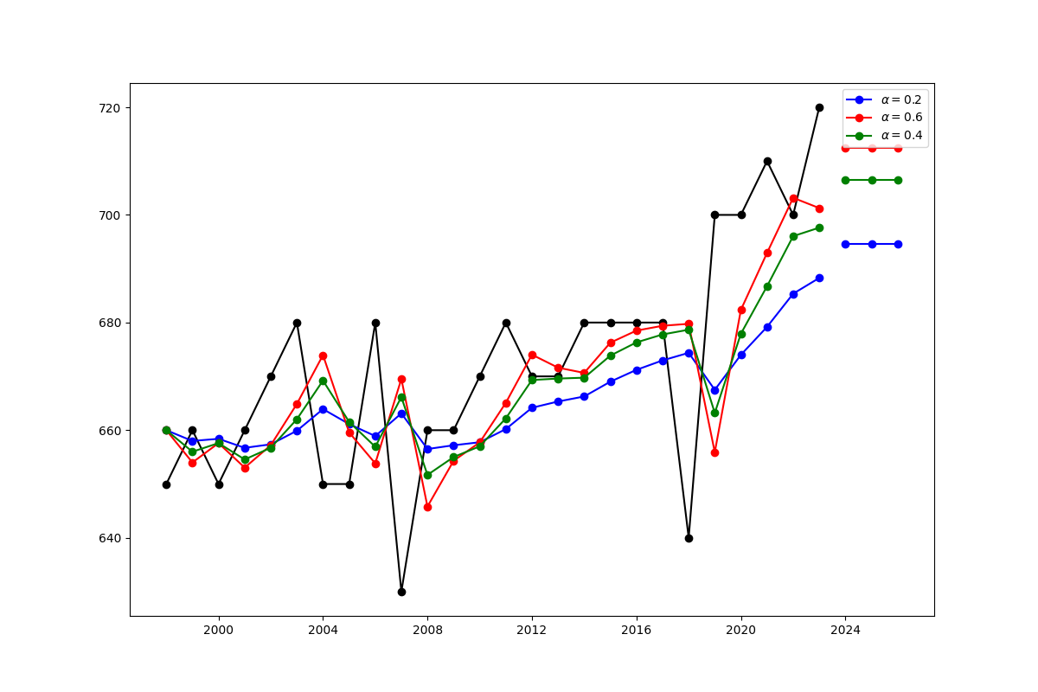
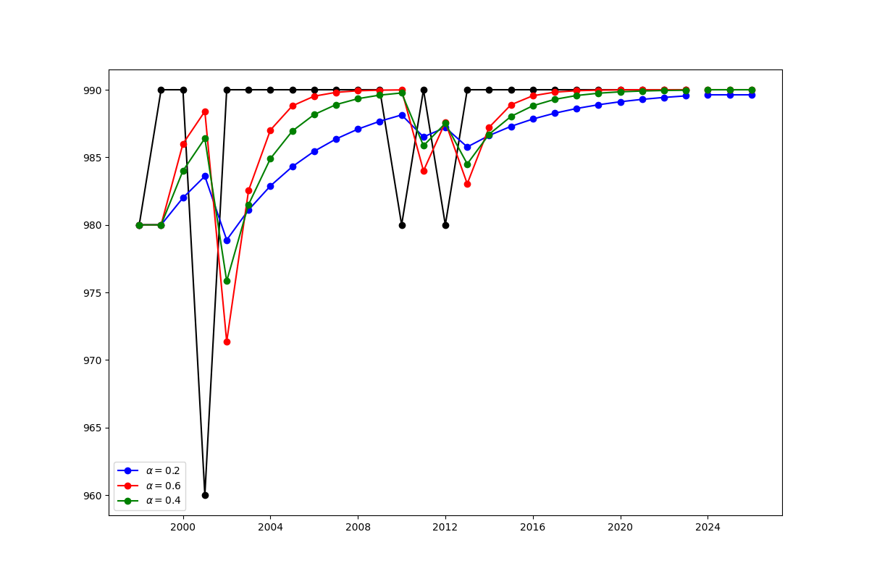
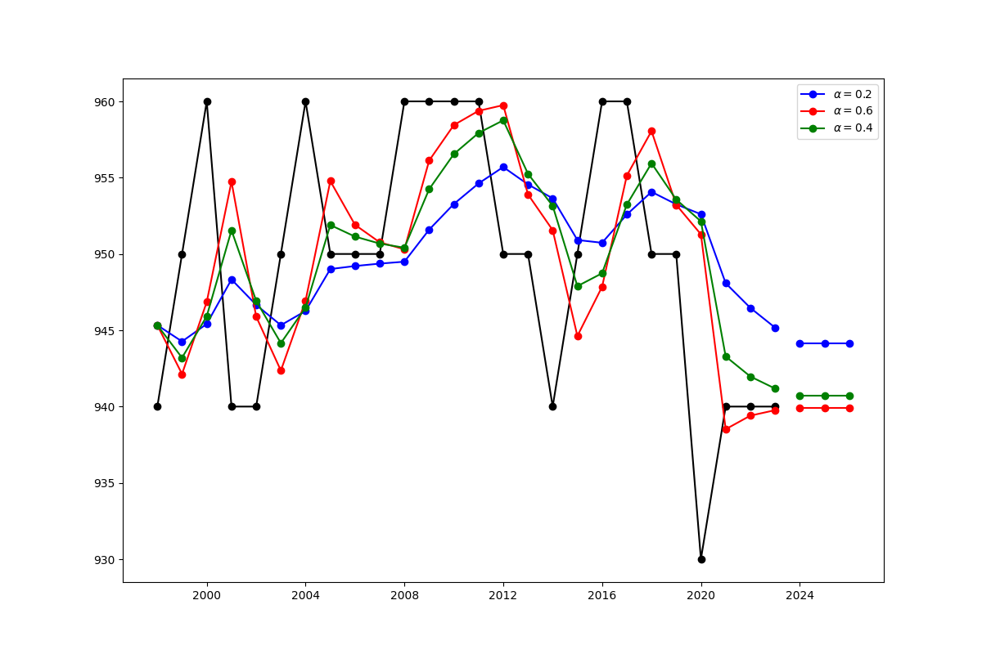
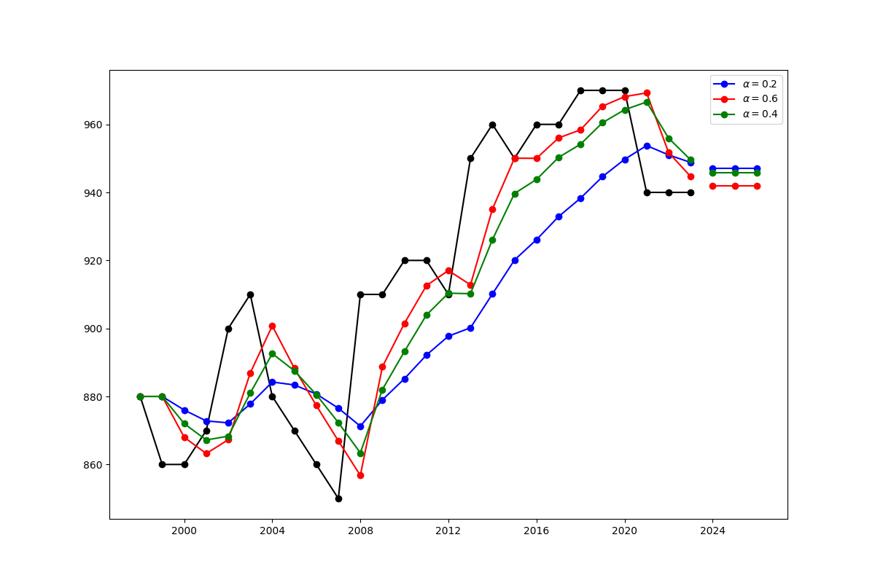
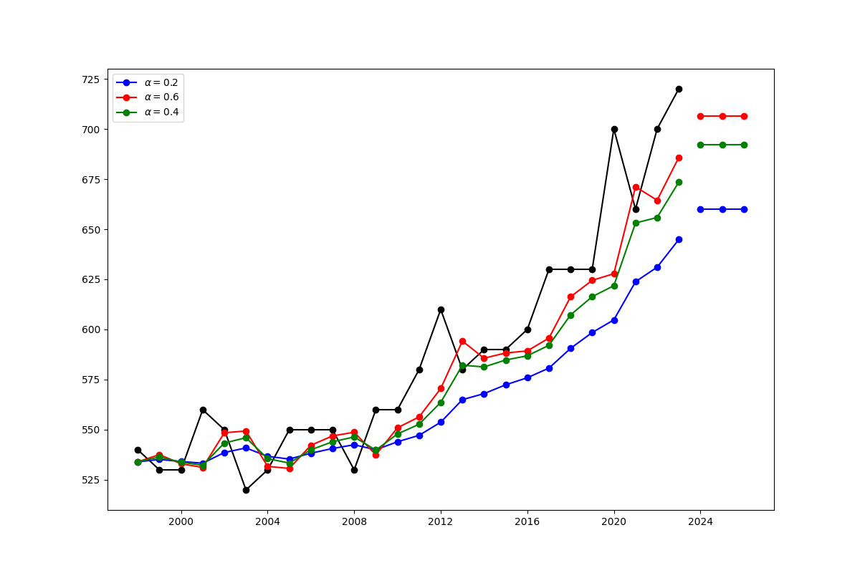
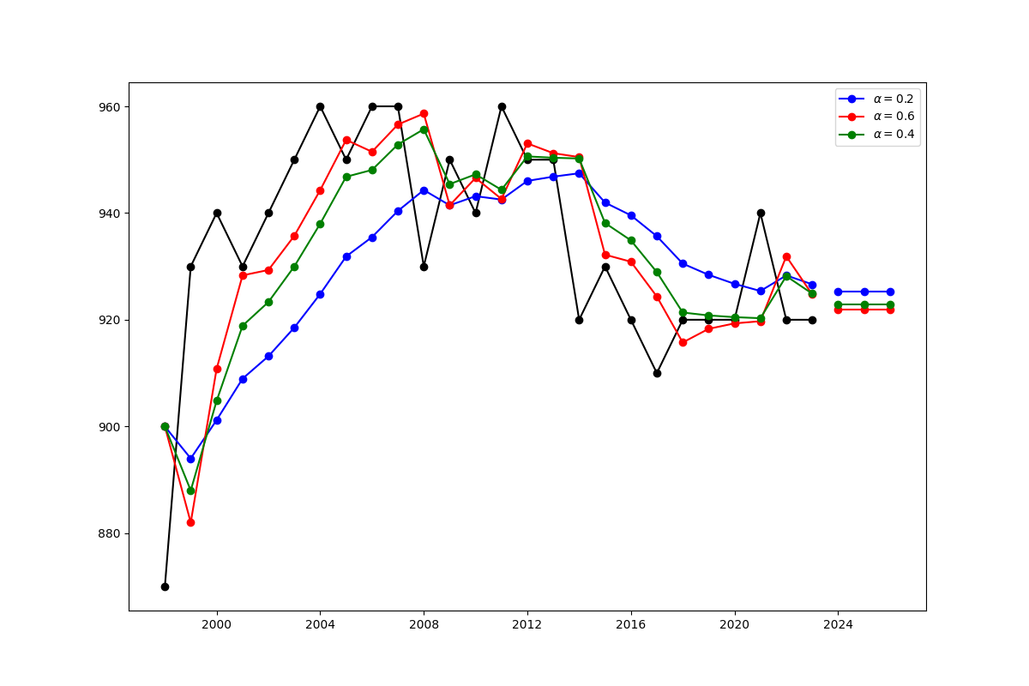
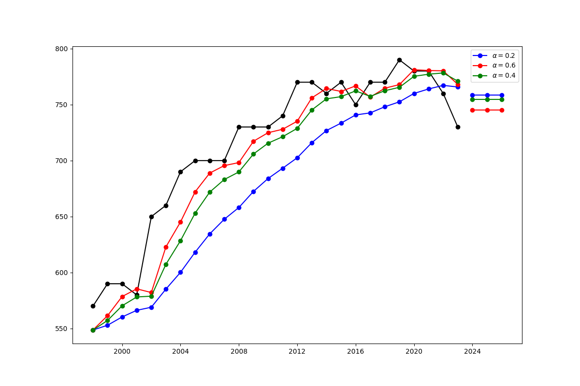
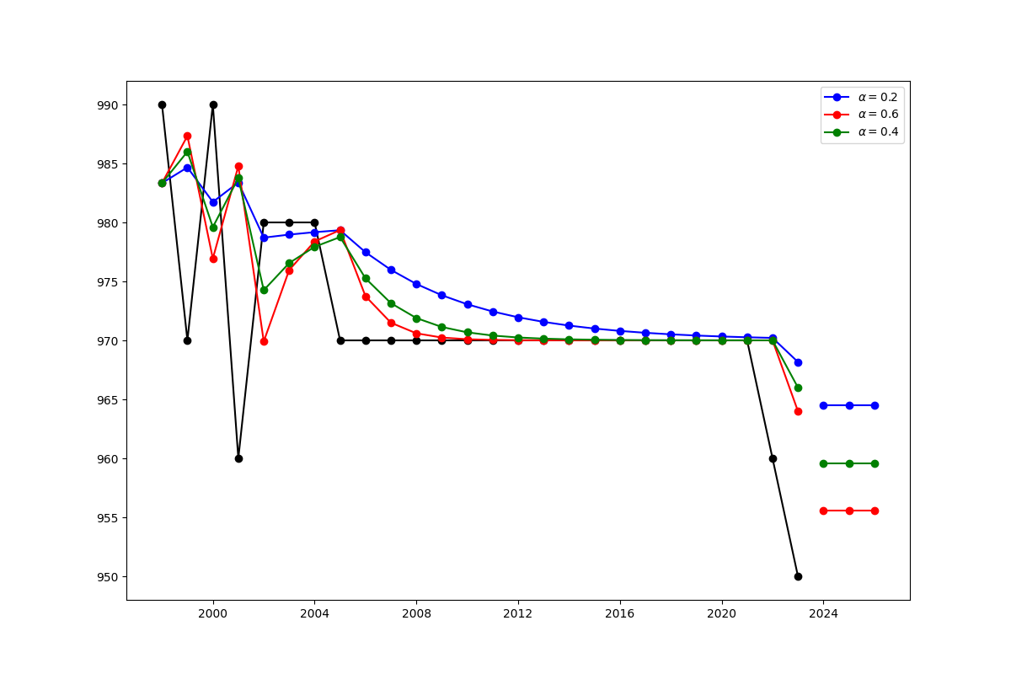
Conclusion

Slide 21
Reference
[1] Chang, F. P. C., & Ouyang, L. Y. (2018). Trend models on the academic ranking of world universities. International Journal of Information and Management Sciences, 29(1), 35-56.
[2] Siniksaran, E., & Satman, M. H. (2020). WURS: a simulation software for university rankings—software review. Scientometrics, 122(1), 701-717.
[3] Gardner Jr, E. S. (1985). Exponential smoothing: The state of the art. Journal of forecasting, 4(1), 1-28.
[4] https://i.imgur.com/rXZOH8e.mp4 (https://www.reddit.com/r/ApplyingToCollege /comments/emz9yu/us_news_college_rankings_1983_2020_top50_schools/)
[5] https://andyreiter.com/datasets/

Slide 22


